Slide 1

SPACEX PROJECT
First Stage Reuse
Kofi Ampomah
1/12/2026

Slide 2
Presentation OutLine
Section
Executive Summary
Introduction
Methodology
Results
EDA with SQL
Interactive Maps with Folium
Plotly Dash Dashboard
Predictive Analytics
Conclusion

Slide 3
Goal
Identify factors linked to successful Falcon 9 first-stage landings to support launch cost prediction.
Approach The data was collected using the SpaceX API and web scraping techniques.Cleaned and transformed data to define landing success.Applied visualization and SQL for exploratory analysis.Built predictive models using logistic regression, SVM, decision tree, and KNN. | Key Insights Landing success improved over time. KSC LC-39A had the highest success rate. Certain orbits achieved consistent success. Most launch sites are near the equator and the coast.
Model Results All models performed similarly. Decision tree showed slightly better performance. | Model Results All models performed similarly. Decision tree showed slightly better performance.

Slide 4
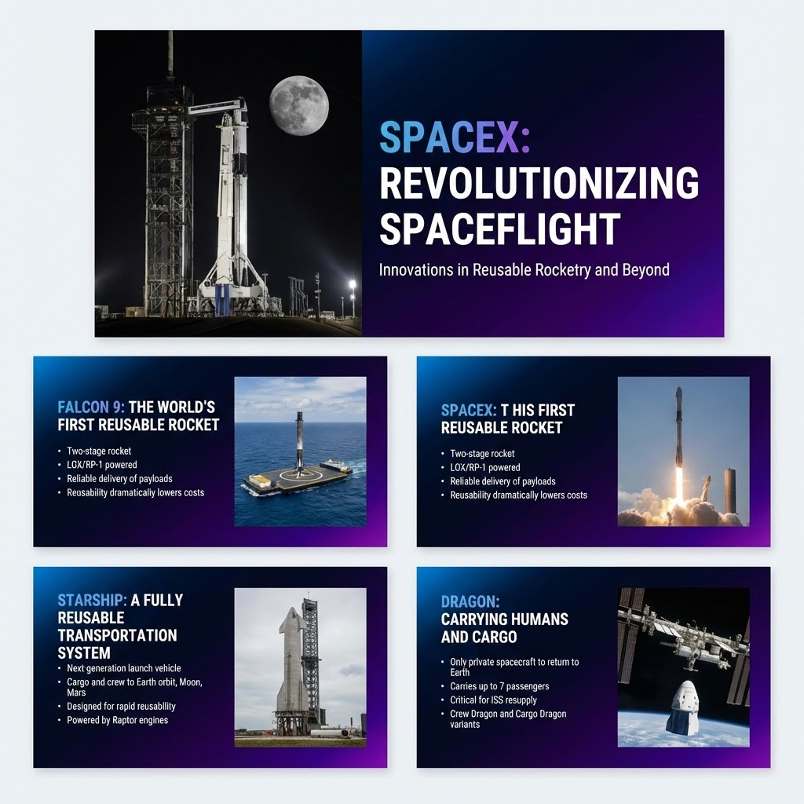
Introduction
Background
SpaceX is a leader in the space industry. The company focuses on lowering launch costs through first-stage reuse. A Falcon 9 launch costs about 62 million dollars. Other providers charge up to 165 million dollars per launch. Cost savings depend on first-stage landing success. Public launch data and machine learning assist in predicting landing outcomes.
Study Focus
Examine how payload mass affects landing success. Analyze the impact of the launch site and flight history. Evaluate orbit types and success trends over time. Identify the best model for binary landing success prediction.

Slide 5


Methodology

Slide 6
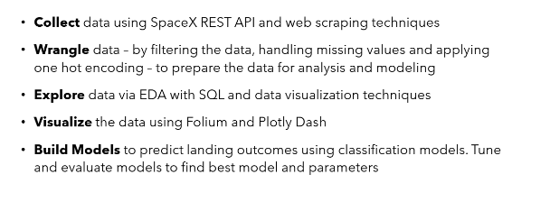
Methodology

Slide 7
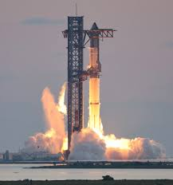
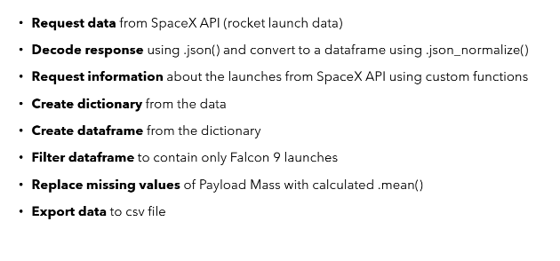
Data Collection -API

Slide 8
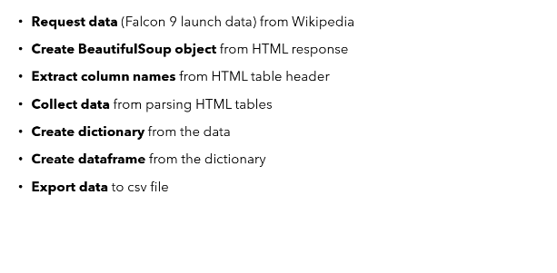
Data Collection -Web Scraping

Slide 9
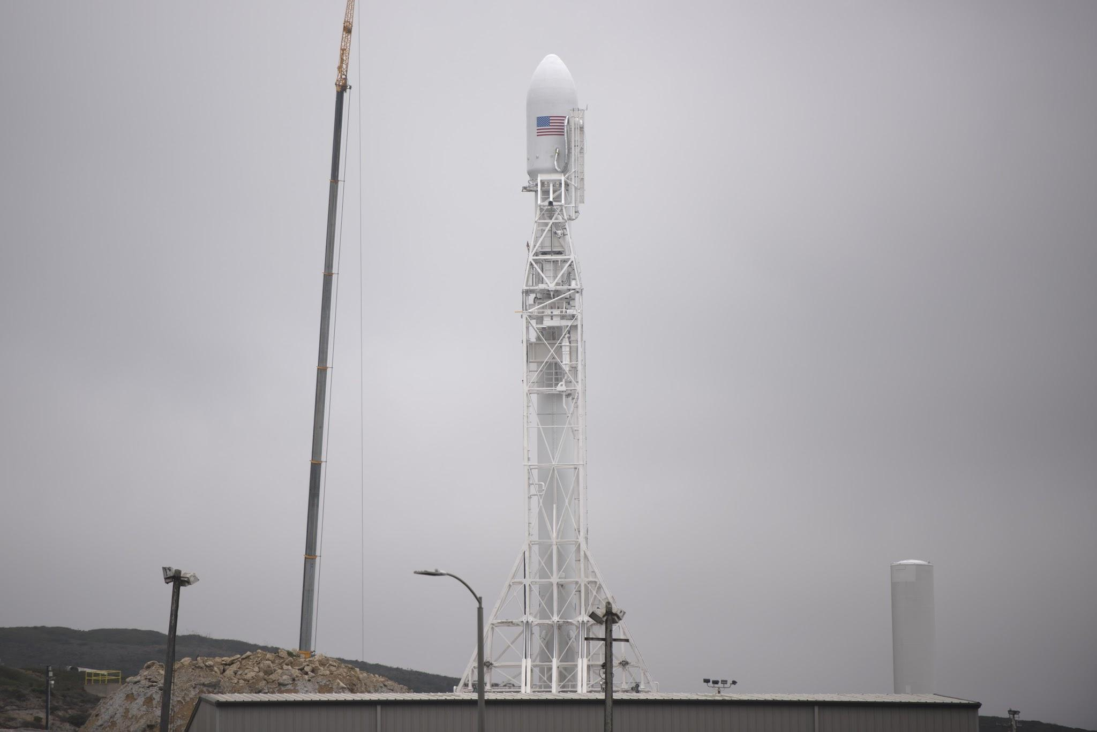
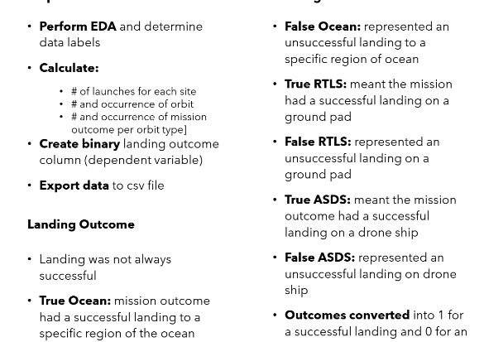
Data Wrangling

Slide 10

Data Wrangling

Slide 11
Data Wrangling

Slide 12
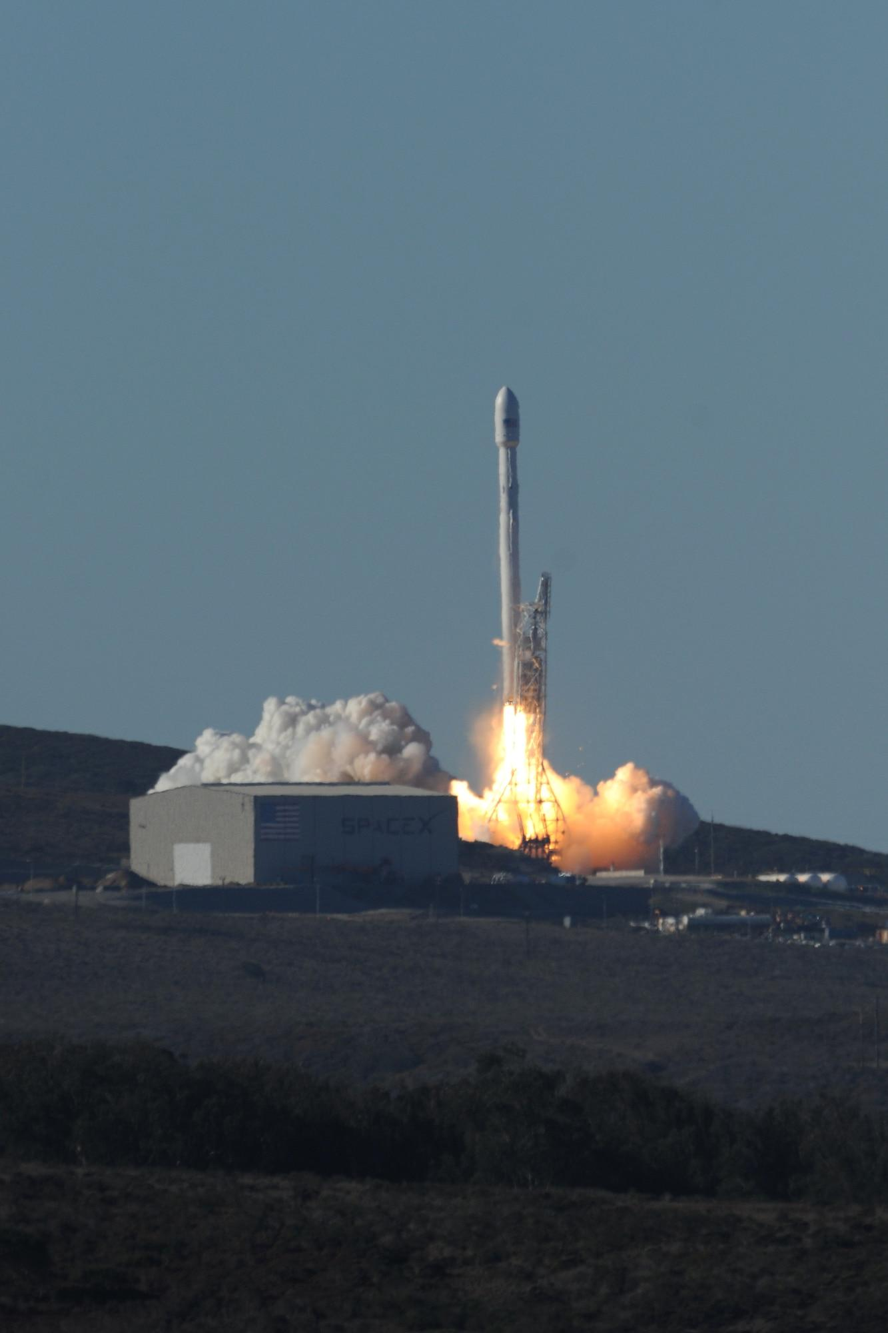
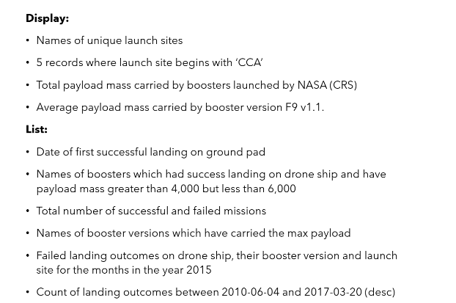
EDA EITH SQL

Slide 13
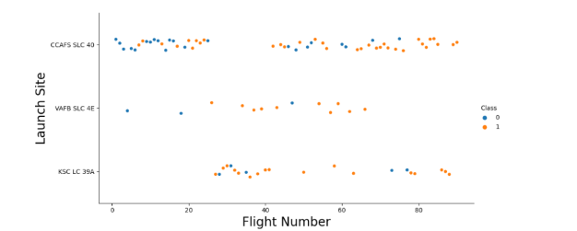
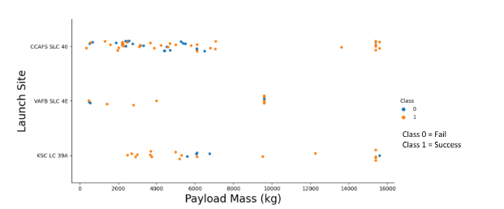
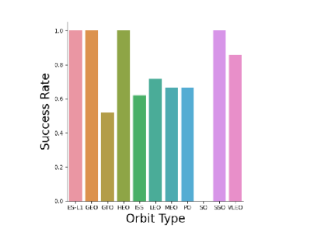
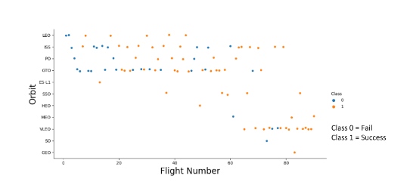
Flight Number vs Launch Site

Slide 14
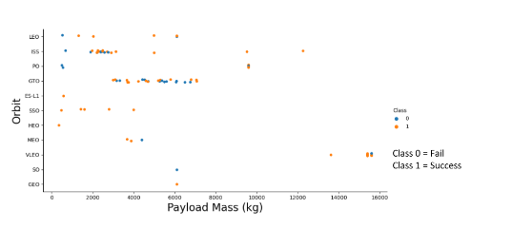
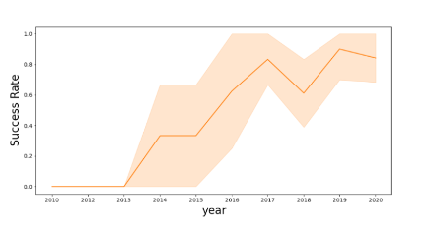
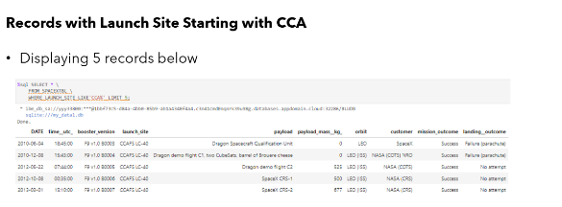
Payload vs Orbit vs Launch Success over Time

Slide 15
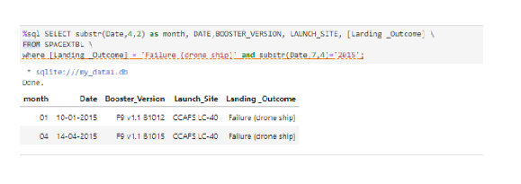
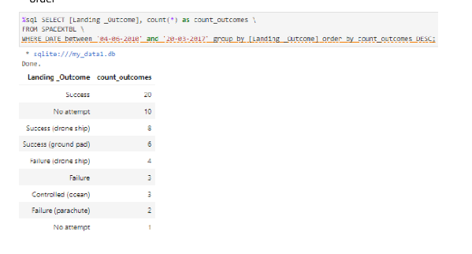
Failed Landing vs Successful Landing

Slide 16
Failed Landing vs Successful Landing

Slide 17
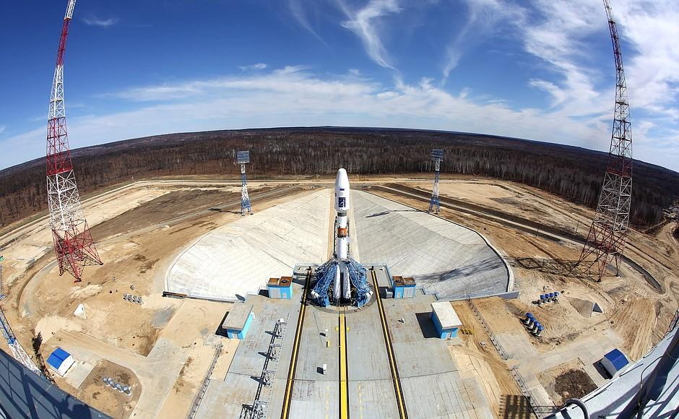
Launch Site Analysis

Slide 18
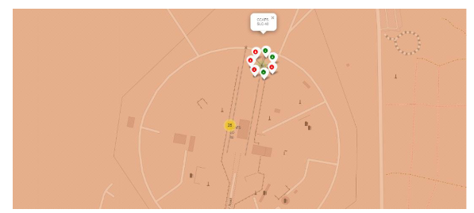
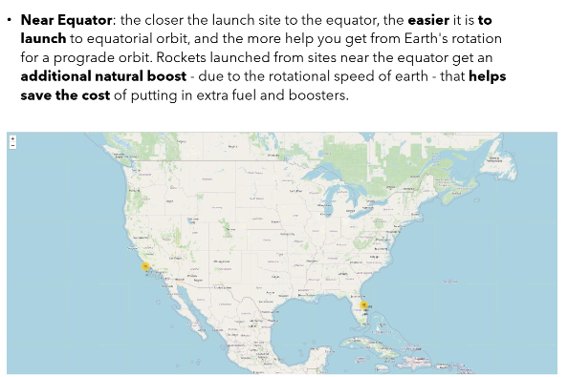
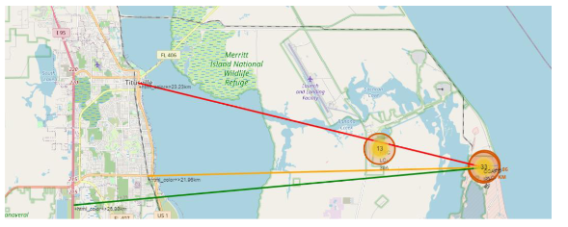
Launch Site vs Launch Outcomes

Slide 19
Launch Site vs Launch Outcomes

Slide 20
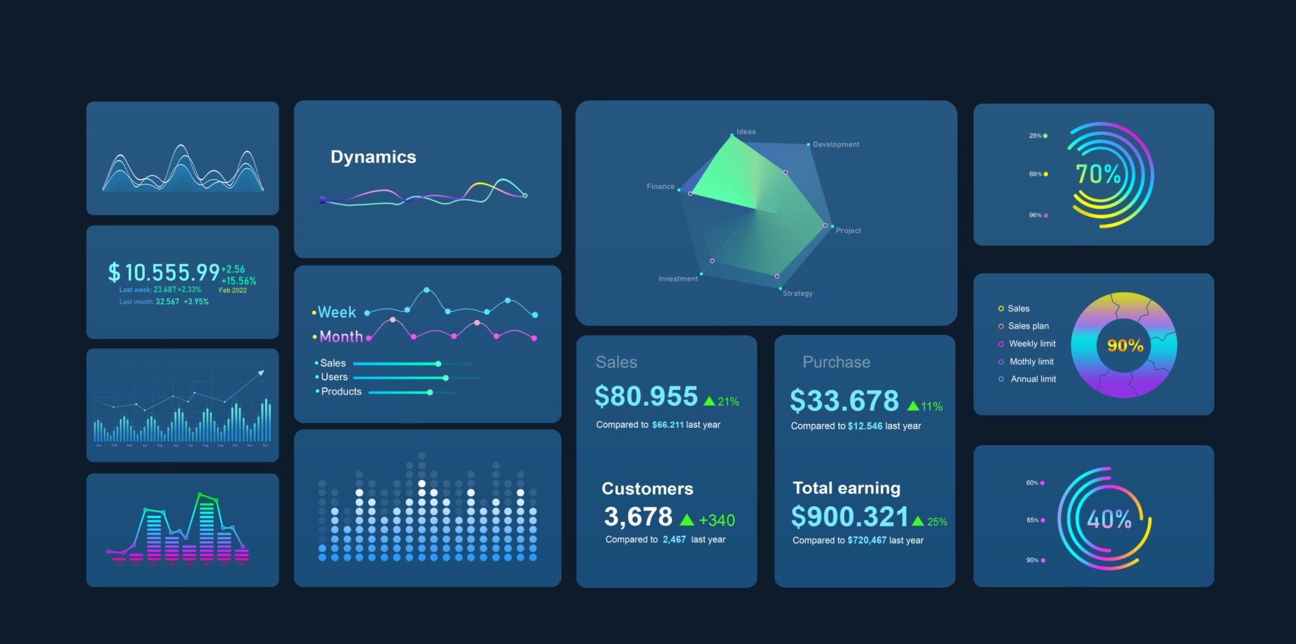
Dashboard with Plotly

Slide 21
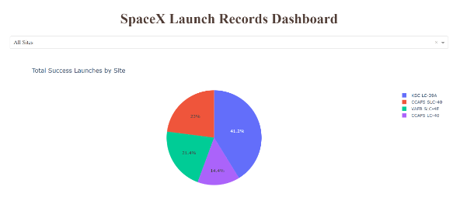
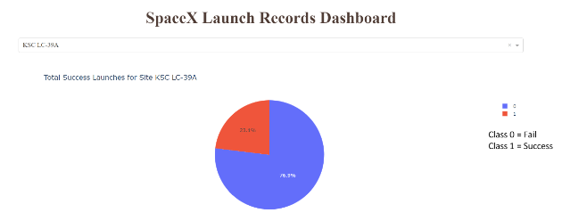
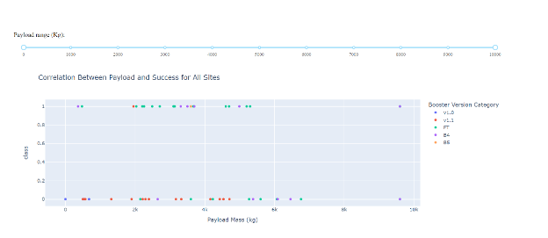
Launch by bSite vs Launch Outcomes

Slide 22
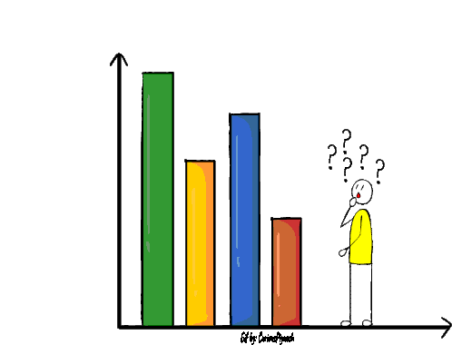
Predictive Analysis

Slide 23
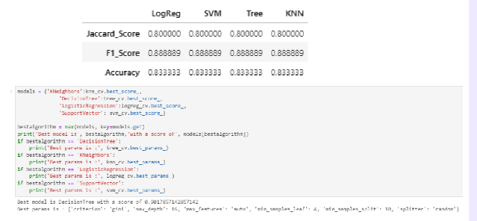
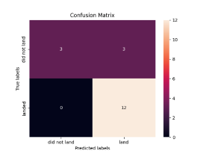
Classification vs Confusion

Slide 24
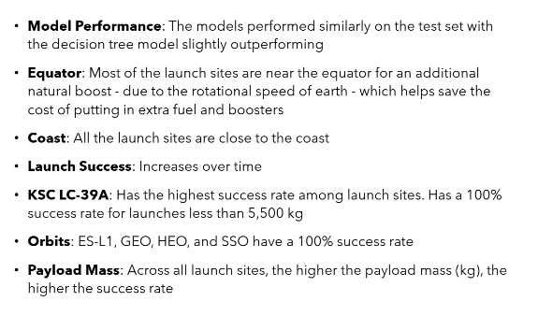
CONCLUSION

Slide 25
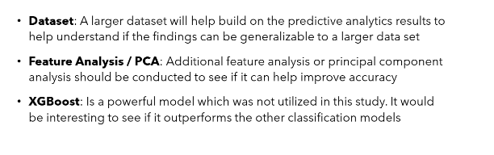
CONCLUSION

